Slide 1
PROJECT OF SUSTAINABLE BUSINESS INNOVATION AND FINANCE
Gislon chiara, passaro JACOPO

Slide 2
OVERVIEW
MAIN GOALS:
- How was the dynamic of ESG score and CO2 Emissions disclosed during the last 3 years?
- Is it possible to determine a correlation between ESG Score and C02 Emissions?
- Does the financial return on capital effectively value environmental performance?
SOURCE: Refinitiv.
TIME PERIOD: from 2019 to 2021.
DATA PERIODICITY: Annual data (FY).
COUNTRIES CONSIDERED: Austria, Belgium, Denmark, Finland, France, Germany, Greece, Iceland, Ireland, Italy, Luxembourg, Malta, Netherlands, Poland, Portugal Spain, Sweden, Switzerlan, Ukraine, UK.
VARIABLES CONSIDERED : ESG Score, CO2 Emissions, ROE («Return on Equity»), Tot. Revenue, Tot. Assets, AVG Employees

Slide 3
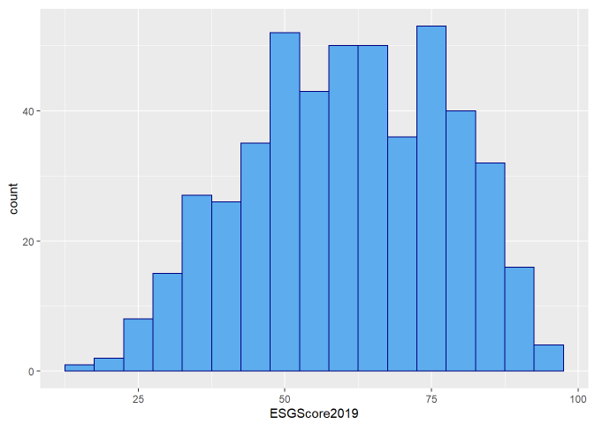
ESG SCORE DISTRIBUTION
General improvement of ESG Scores within the last 3 years.
Average ESG Score for European companies shifted more towards 75/100.

Slide 4
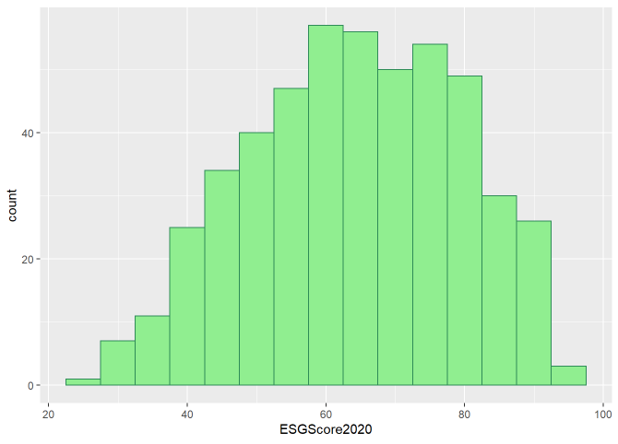
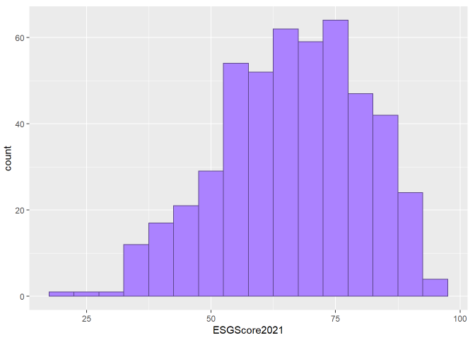

Slide 5
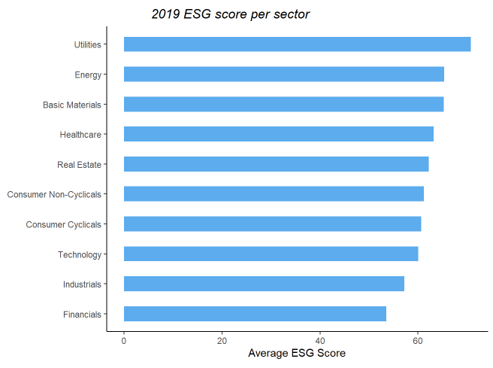
ESG SCORE BY SECTOR
General improvement of their ESG Score among sectors
BEST PERFORMING SECTOR: Utilities
WORST PERFORMING SECTOR: Financials

Slide 6
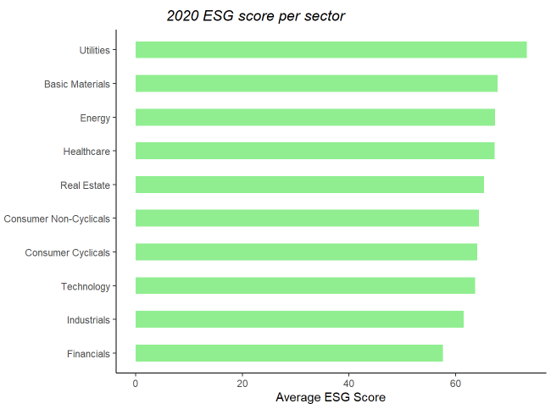
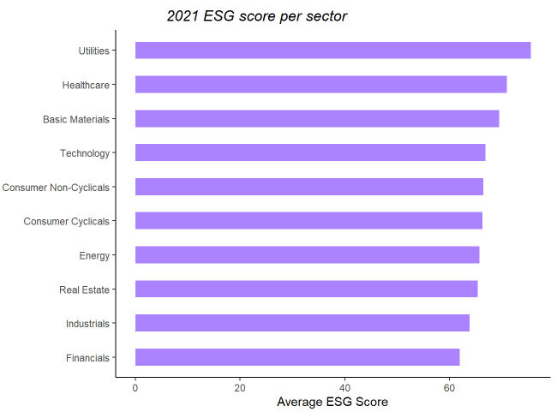

Slide 7
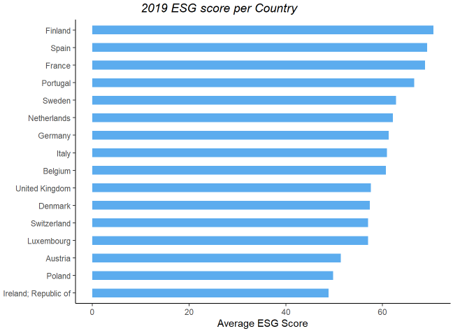
ESG SCORE BY COUNTRY
Most European countries have improved their ESG score
Out of 16 countires considered, Italy and Ireleand were the ones that managed to raise the score.
The opposite happened for UK, Belgium and Sweden

Slide 8
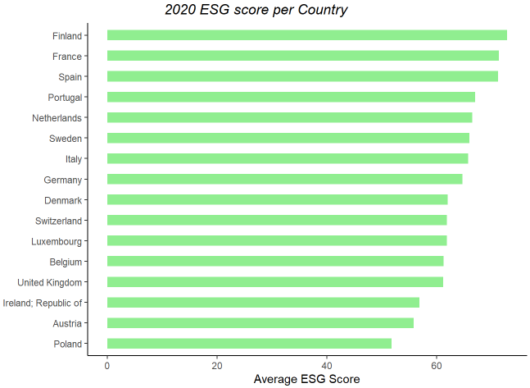
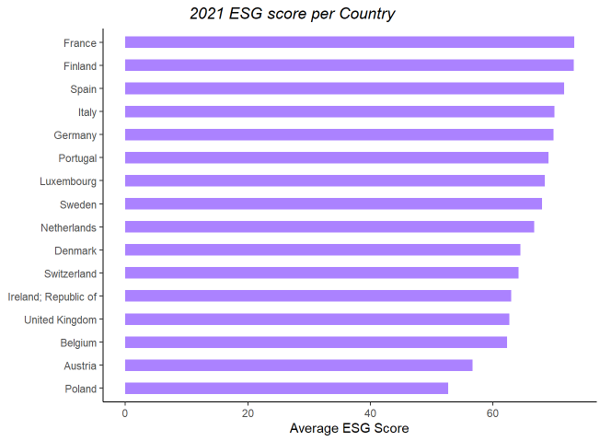

Slide 9
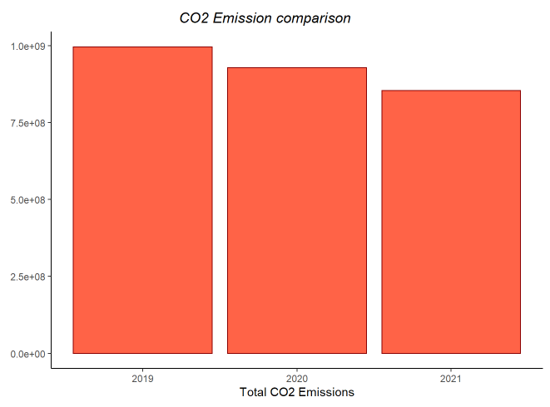
TOTAL CO2 EMISSIONS
Total CO2 emissions have decreased in Europe in the last 3 years.

Slide 10
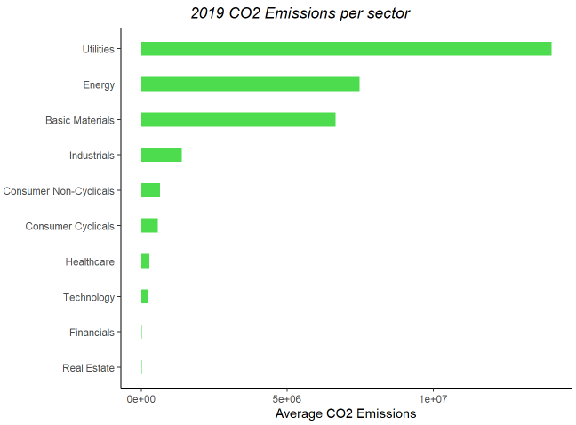
CO2 EMISSIONS BY SECTOR
Utilities, Energy and Basic Materials have always been the most polluting sectors

Slide 11
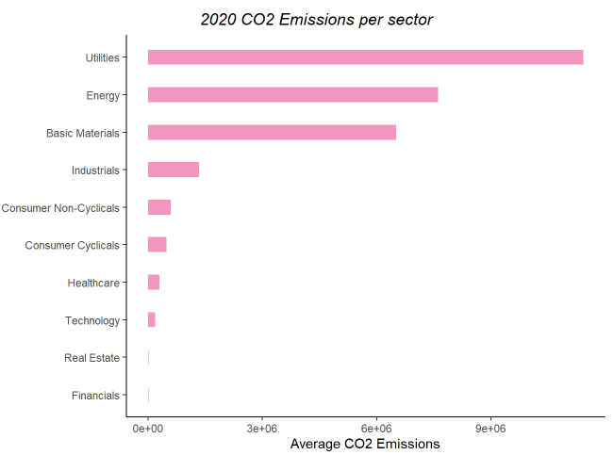
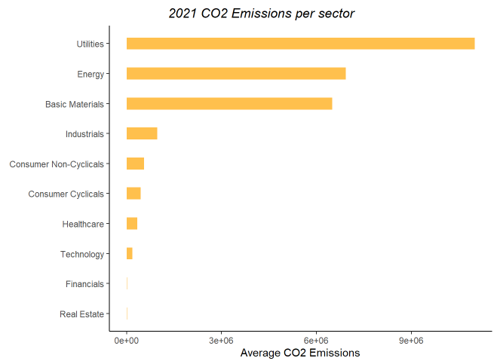

Slide 12
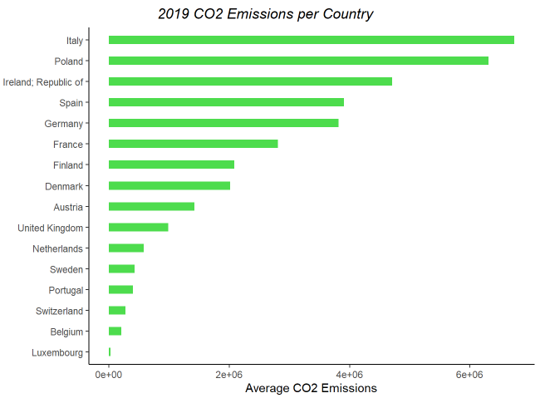
CO2 EMISSIONS BY COUNTRY
General reduction of CO2 emissions for all European countries.
Top 3 countries for CO2 emissions: Poland, Italy and Ireland

Slide 13
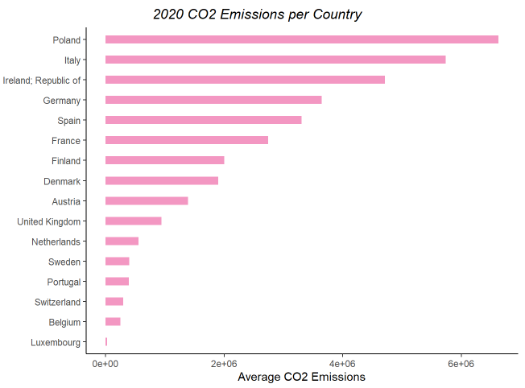
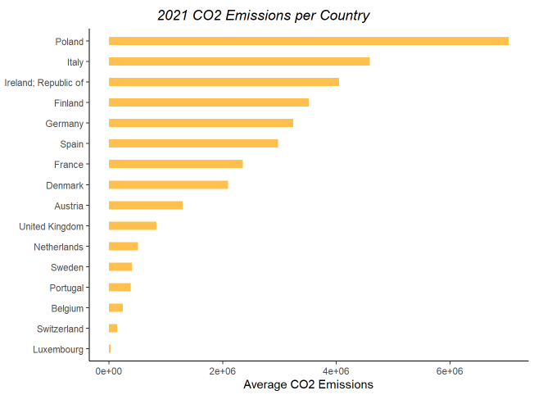

Slide 14
DESCRIPTIVE STATISTICS, per year of analysis
Variables under consideration are characterised by large differences in scale variation
There is a noticeable increase in Mean and Median for ESG Score, while companies performed better in terms of Emissions
Min and Max values of ROE knew an enlargement in their distance, accompanied by an increase in Standard Deviation

Slide 15
CORRELATION TABLES, 2019
Values are splitted to underline a possible correlation between our target variable and independent variables
It is possible to determine a consistent correlation between Environmental scores, Emissions and Revenues

Slide 16
CORRELATION TABLES, 2020
Values are splitted to underline a possible correlation between our target variable and independent variables
The level of correlation between CO2 Emissions and ROE tend to converge to 0 during the period considered

Slide 17
CORRELATION TABLES, 2021
Values are splitted to underline a possible correlation between our target variable and independent variables
Decrease in correlation between ESG and ROE; switch from positive to negative in the correlation between CO2 and ROE

Slide 18
Linear Regression Model
ROE = Dependent Variable
ESG Score, log(C02 Emissions) = Independent Variables
Log(TotRevenue), log(TotAssets), log(Employees) = Structural Variables
NULL HYPOTHESIS = There is no relevance in Environmental Indicators for Return on Equity

Slide 19
Linear Regression Model
Year : 2019
No statistical significance referring to ESG Score on ROE
A unit percentage increase in CO2 Emissions translates with statistical significance into an expected decrease in ROE of 0,0075 (0,34378)

Slide 20
LINEAR REGRESSION MODEL
Year 2020
Do not reject Null Hypothesis for ESG Score : p-value = 0,3771
There is an increase in significance for C02 Emissions : a unit percentage increase in Emissions translates into an expected decrease in ROE of 0,0112
Low R^2 = 0,058, given a lot of observations and many non included varibales we are not able to assume that this model could be so explanatory

Slide 21
LINEAR REGRESSION MODEL
Year 2021
No influence in the ESG measurements
For the year 2021 the statistical significance for CO2 Emissions is canceled (p-value = 0,0672), we could think to some systemic changed condition

Slide 22
Dummy Variables for Sectors & Interactions between ESG Score and CO2 Emissions
In order to take into account differences between sectors and find out if there is some determing relevance in ROE
We split our data grasping information about Basic Materials, Energy, Industrials, Technology, Utilities, Financials
And including dummy variables and interactions for levels of Enviromental Performance
- Year 2019, Basic Materials Sector

Slide 23
Dummy Variables for Sectors & Interactions between ESG Score and CO2 Emissions
- Year 2019, Utilities

Slide 24
Dummy Variables for Sectors & Interactions between ESG Score and CO2 Emissions
- Year 2019, Energy

Slide 25
Dummy Variables for Sectors & Interactions between ESG Score and CO2 Emissions
2019, Industrials

Slide 26
Dummy Variables for Sectors & Interactions between ESG Score and CO2 Emissions
2019, Financials

Slide 27
Dummy Variables for Sectors & Interactions between ESG Score and CO2 Emissions
- Year 2019, Technology

Slide 28
Dummy Variables for Sectors & Interactions between ESG Score and CO2 Emissions
- Year 2020, Basic Materials

Slide 29
Dummy Variables for Sectors & Interactions between ESG Score and CO2 Emissions
- Year 2020, Utilities

Slide 30
Dummy Variables for Sectors & Interactions between ESG Score and CO2 Emissions
- Year 2020, Energy

Slide 31
Dummy Variables for Sectors & Interactions between ESG Score and CO2 Emissions
- Year 2020, Financials

Slide 32
Dummy Variables for Sectors & Interactions between ESG Score and CO2 Emissions
- Year 2020, Technology

Slide 33
Dummy Variables for Sectors & Interactions between ESG Score and CO2 Emissions
- Year 2020, Industrials

Slide 34
Dummy Variables for Sectors & Interactions between ESG Score and CO2 Emissions
- Year 2021, Basic Materials

Slide 35
Dummy Variables for Sectors & Interactions between ESG Score and CO2 Emissions
-Year 2021, Utilities

Slide 36
Dummy Variables for Sectors & Interactions between ESG Score and CO2 Emissions
- Year 2021, Energy

Slide 37
Dummy Variables for Sectors & Interactions between ESG Score and CO2 Emissions
- Year 2021, Industrials

Slide 38
Dummy Variables for Sectors & Interactions between ESG Score and CO2 Emissions
- Year 2021, Technology

Slide 39
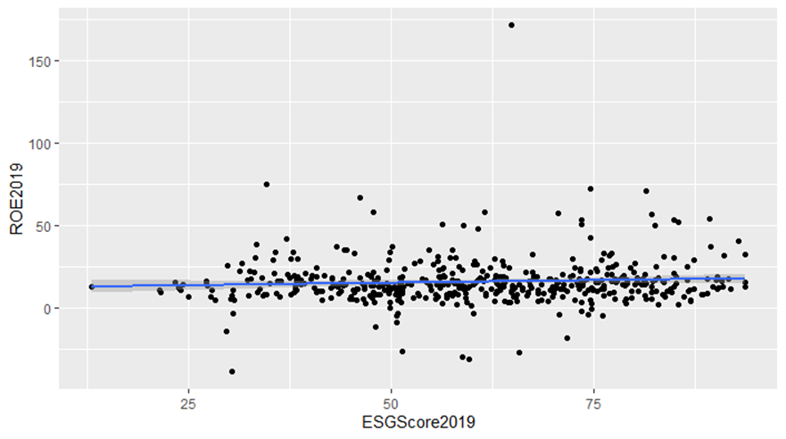
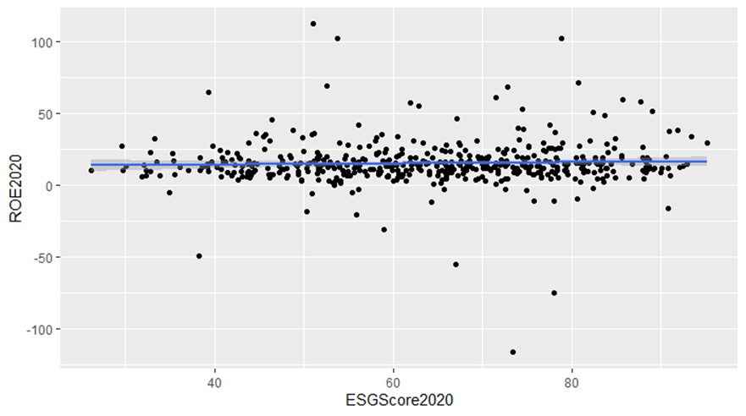
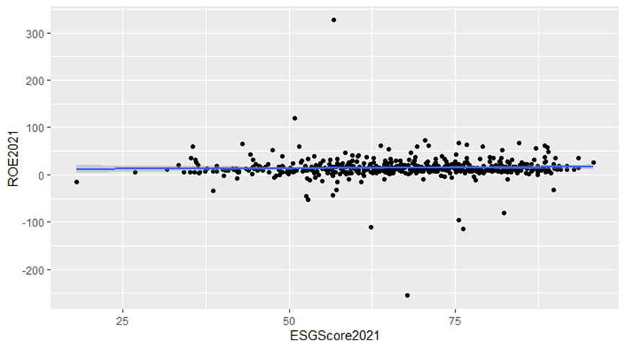

Slide 40
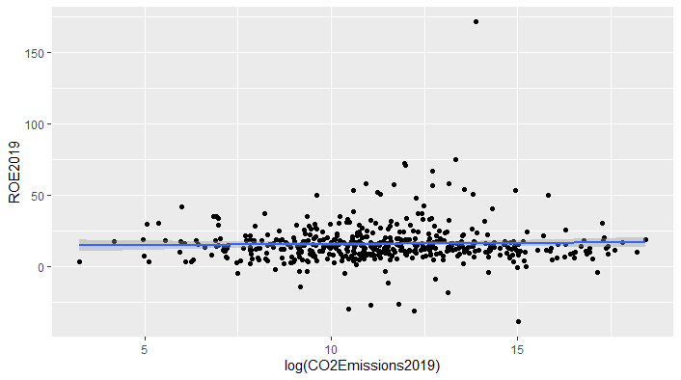
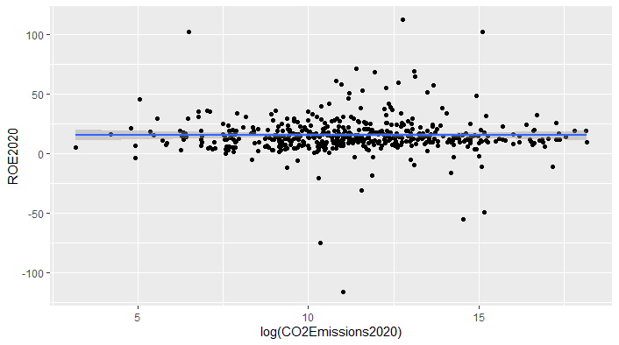
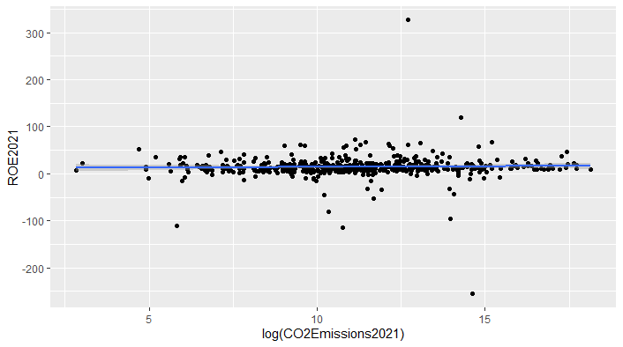

Slide 41
CONCLUSIONS
The dynamic of Environmental Performance Indicators improved during last 3 years among listed companies of the European Continent
It has been determined a positive correlation between CO2 Emissions and ESG Score, so there is not an inverse relation between bad emission performances translating into low ESG scores. Currently it is difficult to determine a positive correlation that links financial return on capital and Environmental Performances
ROE seems to be not affected by ESG Score over the considered period, while taking more into consideration a performance in terms of CO2 Emissions
Considering different sectors and the interaction between Dummy variables for our Environmental measures does not produce so much relevance according to our results. We found out statistical significance for Basic Materials and Utilities during 2019, and for the Energy sector during 2021

Slide 42

THANKS FOR YOUR ATTENTION
Chiara Gislon , Jacopo Passaro

